Slide 1

Machine Learning – Certification Program (Aug 2018)
Code Assignment – Module 4
Phone : +91 9999658436
Offices : Bengaluru, New Delhi
Email : contact@cellstrat.com
Web : www.cellstrat.com
CellStrat™ Confidential. All Rights Reserved.

Slide 2
Module 4
Data Preparation

Slide 3

Tutorial – Data Preparation
Q1) Review the training dataset (excel file). Note that weight is missing for 5th row ie Asian, Height 178 cm. Also note that Height is missing for 8th row ie White, Weight 89 kgs.
What is the value computed by the imputer for these two missing columns
Asian Weight=85.25
White height=180.0
Q2) In the programming code, find the call to the Imputer class. Replace strategy parameter from ‘mean’ to ‘median’ and run the output again.
What is the new value assigned to blank fields Weight and Height for the two rows
Remains Same
Q3) Review the code and explain the function of OneHotEncoder
It converts labels into matrix comprising of 1’s and 0’s.
We import and define function with categorical_features into a variable and we this new variable as function and apply it on data
Q4) After OneHotEncoder code in the tutorial, why does the array X has 5 columns instead of 3 columns as before
Onehot encoder generated 3*matrix with 1’s and 0’s..here we have 3 values in index(label) variable,so we have 3*3 matrix
Q5) the function train_test_split is splitting data into 20% test data and 80% training data. Try test_size of 0.3 instead, run the program again and explain the output of the program.
Now after test_size turned to .3 ..we have 30% test and 70% train data..output is reduced by 1 row

Slide 4
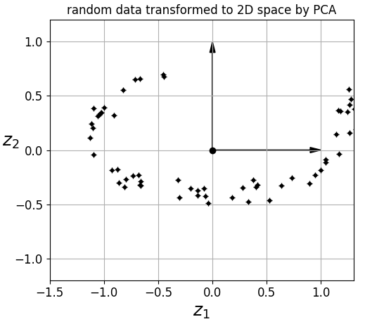
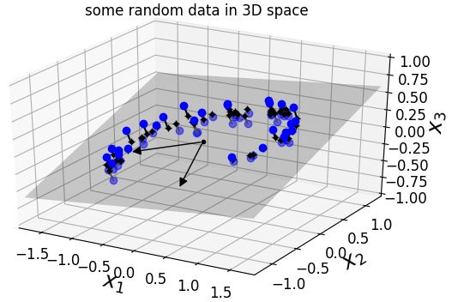
Tutorial – Dim Reduction
Q1) In the PCA output chart on random data (“some random data in 3D space” plot), what does the hyperplane shadow represent ?
It is plane drawn through the space where most of the data distributed. It is drawn across dimensions. Helps to reduce dimensions

Slide 5
Tutorial – Dim Reduction
Q2) What is the reconstruction error after PCA transformation (hint – check the output of the program) and provide interpretation of it.

Slide 6
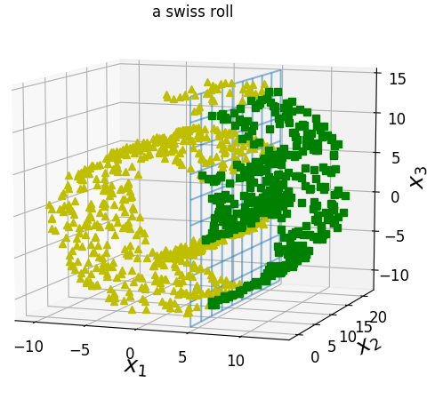
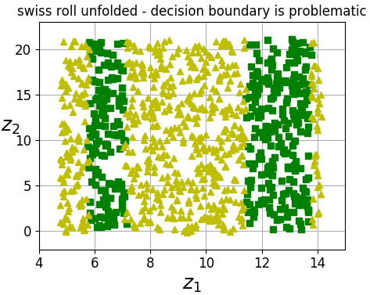
Tutorial – Dim Reduction
Q3) In the various swiss rolls created in this program, why is the manifold learning not able to create classifier boundary for ALL the unrolled rolls ? E.g. Check the below manifold.

Slide 7
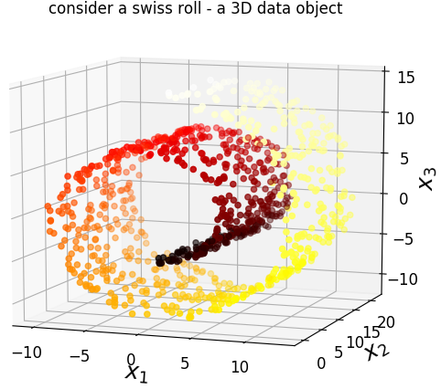
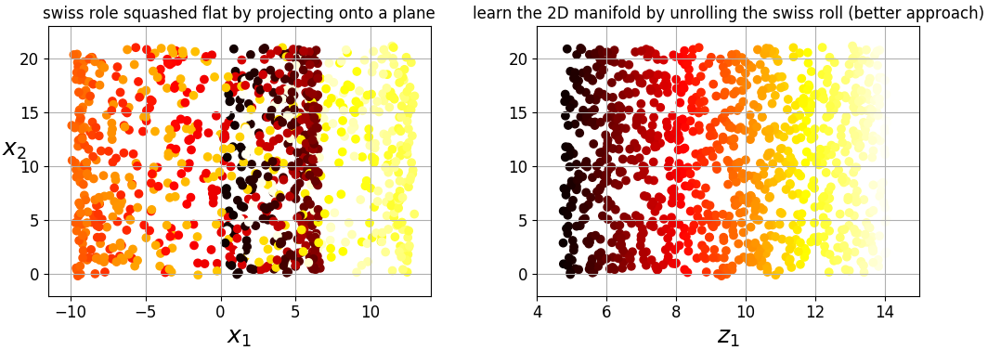
Tutorial – Dim Reduction
Q4) What is the difference between squashing the swiss roll flat vs unrolling it ?

Slide 8
Tutorial – Dim Reduction
Q5) How does PCA algorithm actually work ?

Slide 9
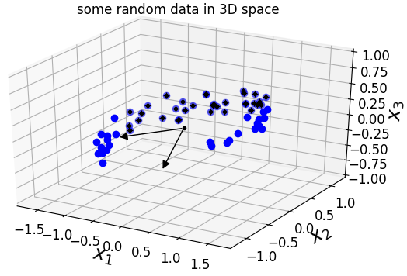
Tutorial – Dim Reduction
Q6) In Line of code (Cell 5), where we set pca = PCA(n_components = 2), change the code and set the n_components = 3 and check the output after PCA. What do you see and why ?

